Slide 1

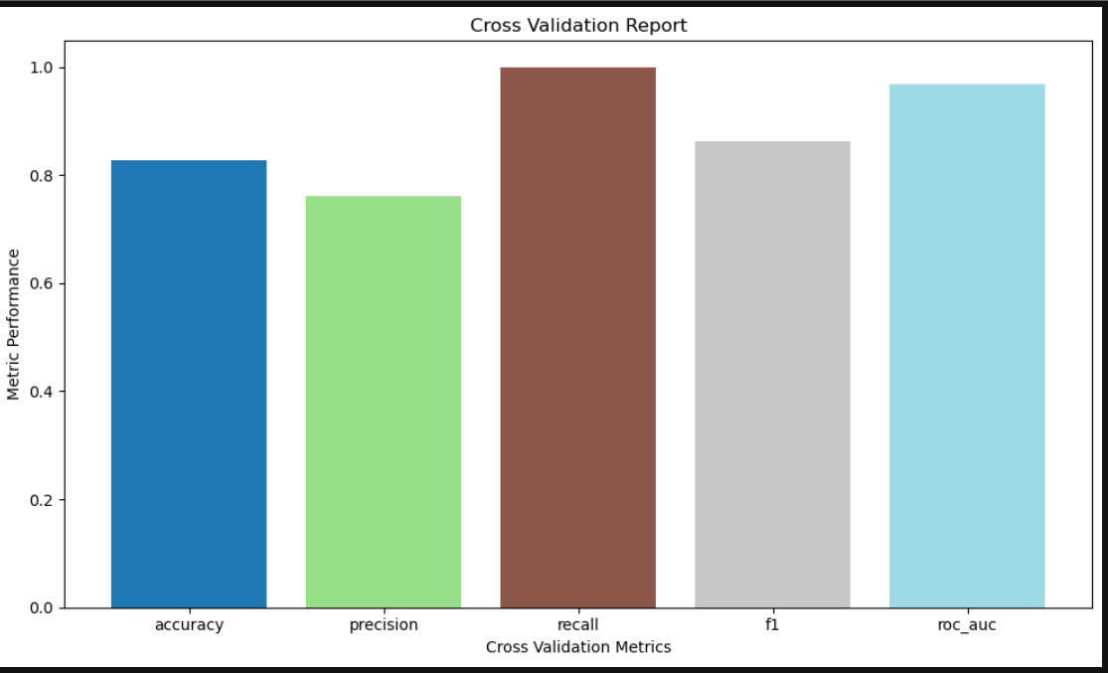
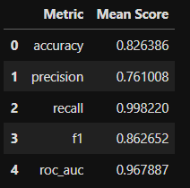
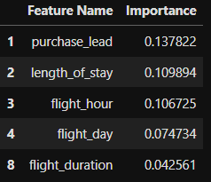
Topic : Predicting Customer Booking Intent for British Airways Using Machine Learning
MODEL PERFORMANCE
Training Score : 99.91%
Test Score : 95.97%
CROSS VALIDATION METRIC AND VISUALIZATION REPORT
5 MOST IMPOTANT FEATURES

